Slide 1

Sentiment Analysis of COVID - 19 Tweets-
Visualization Dashboard
BY-
Manasi Bendale
Dhruvilsinh Jhala
(Cookie Army)

Slide 2
INTRODUCTION
Twitter is a popular microblogging service where users create status messages (called "tweets"). These tweets are a way to express opinions of an individual about different topics. Due to the outbreak of CoronaVirus, twitter has become a popular platform to express individuals' views on the current scenario.
The purpose of this project is to build an algorithm that can accurately classify Twitter messages as positive, negative or neutral.

Slide 3
PROBLEM STATEMENT
●Gathering and analysing the reaction of a country's population to various events occuring in the country requires a lot of time and space without proper visual aids.
●Going through billions of reactions will require a large amount of time and hence is impossible to be done by humans.
●The data has to be collected, sorted, analysed and classified based on the sentiment. The result after analysis will be difficult to understand without proper visualization techniques.

Slide 4
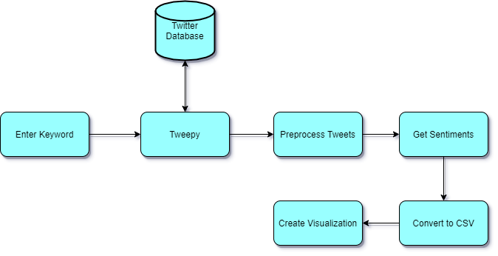
FLOWCHART

Slide 5
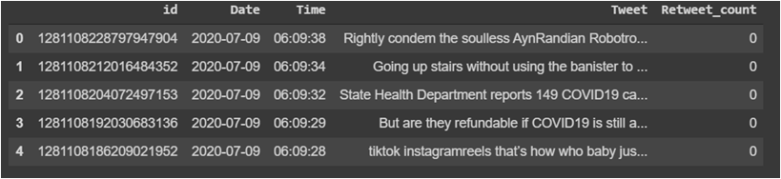
DATA PREPROCESSING
◦Removing mentioned people
◦Removing special characters and punctuation
◦Removing link in tweets; if present
◦Removing ascii characters

Slide 6
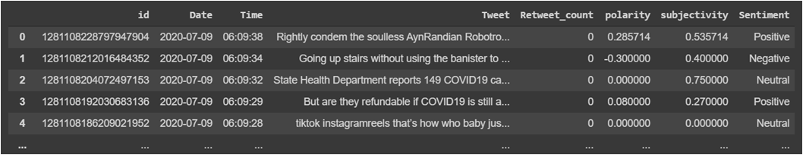
ADDING POLARITY AND SENTIMENT
◦If polarity > 0,then it is positive sentiment
◦If polarity<0,then it is negative sentiment
◦If polarity=0,then it is neutral sentiment

Slide 7
VISUALIZATION
We used the Cognos Dashboard in Watson Studio for Visualization
With the help of Cognos dashboard, we plotted the csv file for percentage of different sentiment categories ,viz. ,positive , negative etc. for each of the different phases using pie chart.

Slide 8
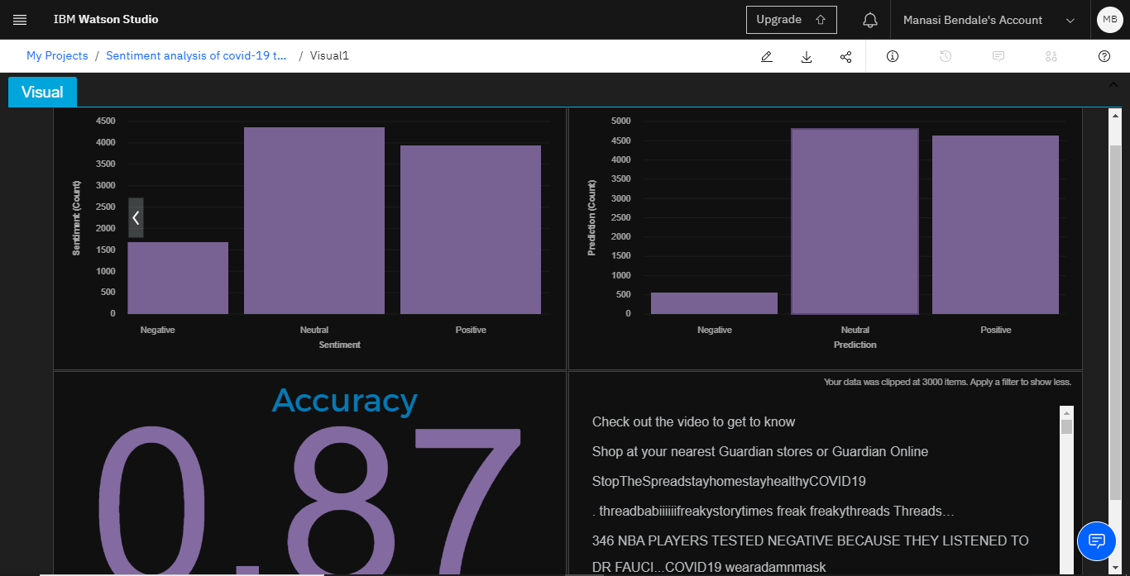

Slide 9
CONCLUSION
In this project, the overall trend shows that the public has been more optimistic over time. Digging into the sentiment analysis, we found that the sentiment “Assertive” went up, and “Fearful” went down through the time. At last, the topics behind the sentiments unfolded more details.
To fight the coronavirus not only needs the guidance from the government but also a positive attitude from the public. Our analysis provides a potential approach to reveal the public’s sentiment status and help institutions respond timely to it.

Slide 10
THANK YOU !
04

